Slide 1
MASTERING SPREADSHEET
S2 BCOM

Slide 2
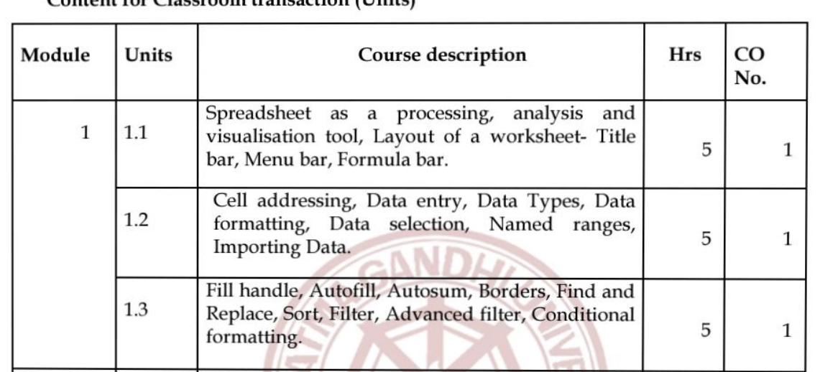

Slide 3
LIBREOFFICE
LibreOffice is a freely available, fully-featured, open source office productivity suite that is compatible with other major office suites and is available on a variety of platforms.
Its native file format is Open Document Format (ODF), and it can also open and save documents in many other formats, including those used by several versions of Microsoft Office.
For more information, see Appendix B, Open Source, Open Standards, OpenDocument.

Slide 4
LIBREOFFICE CALC
Calc (spreadsheet) Calc has all of the advanced analysis, charting, and decision making features expected from a high-end spreadsheet.
It includes over 500 functions for financial, statistical, and mathematical operations, among others.
The Scenario Manager provides “what if” analysis.
Calc generates 2D and 3D charts, which can be integrated into other LibreOffice documents.
You can also open and work with Microsoft Excel workbooks and save them in Excel format.
Calc can also export spreadsheets in several formats, including for example Comma Separated Value (CSV), Adobe PDF and HTML formats.

Slide 5
Other features provided by Calc include:
• Functions, which can be used to create formulas to perform complex calculations on data.
• Database functions, to arrange, store, and filter data.
• Dynamic charts, including a wide range of 2D and 3D charts.
• Macros, for recording and executing repetitive tasks; scripting languages supported include LibreOffice Basic, Python, BeanShell, and JavaScript.
• Ability to open, edit, and save Microsoft Excel spreadsheets.
• Import and export of spreadsheets in multiple formats, including HTML, CSV (without or with formulas), dBase, PDF, and PostScript.
• Collaborate with others seamlessly by sharing the spreadsheet.

Slide 6
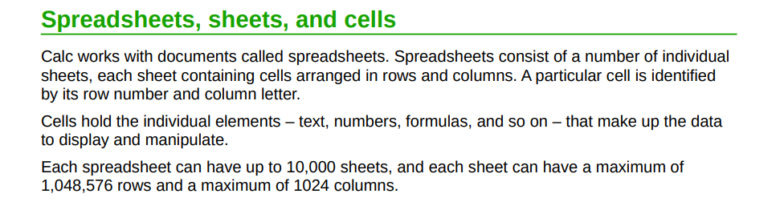

Slide 7
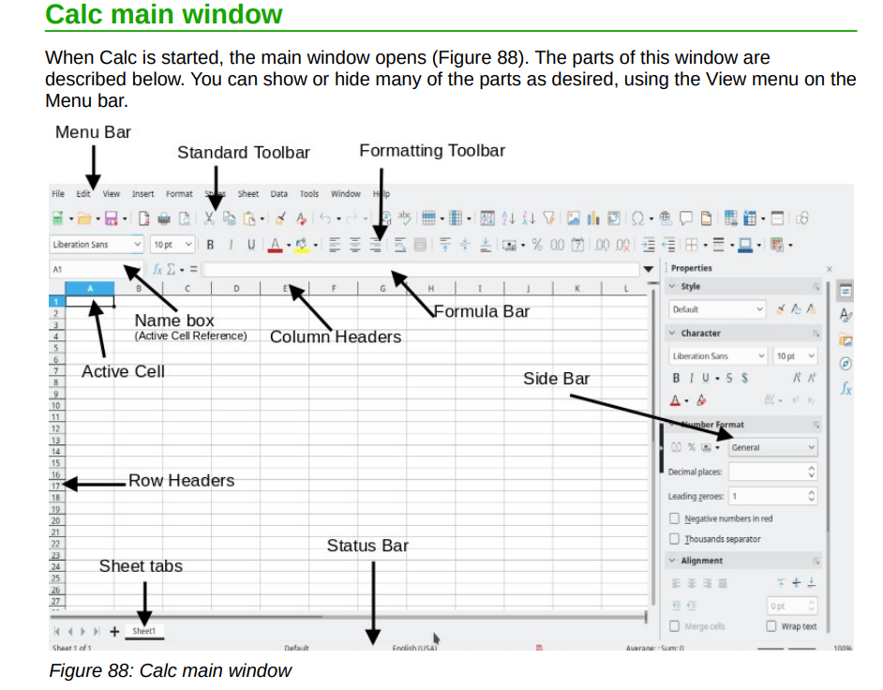

Slide 8
TITLE BAR
The Title bar is located at the top of the LibreOffice window. It shows the file name of the current document.
When the document is not yet named, the document name will appear as Untitled X, where X is a number.
Untitled documents are numbered in the order in which they are created.

Slide 9
MENU BAR
The Menu bar is located just below the Title bar in Windows and Linux and at the top of the screen in macOS.
When you select one of the menus, a submenu drops down to show further options, including:
• Commands that directly cause an action, such as Close or Save in the File menu.
• Commands that open dialogs. These are indicated by three dots following a command, such as Find and Replace... in the Edit menu.
• Commands that open further submenus.
These are indicated by a right-pointing arrow following a command, such as Toolbars and Zoom, in the View menu.
Moving the cursor onto one of these items causes its submenu to open.

Slide 13
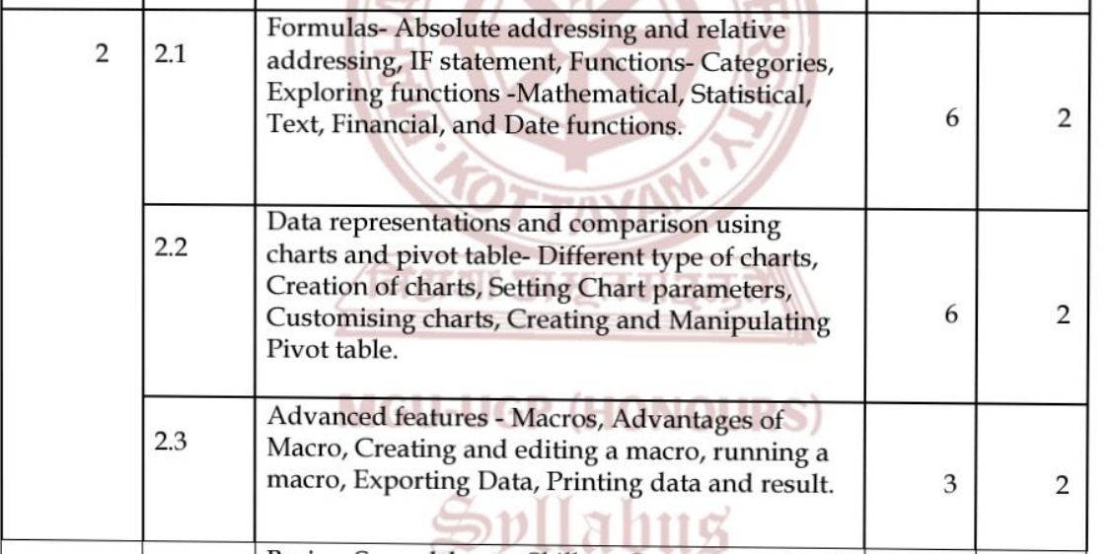

Slide 23
